Slide 1
Chapter 2: Carbohydrates

Slide 2
Contents
2.1. Introduction
2.2. Classification of carbohydrates
2.3. Monosaccharides
2.3.1. Introduction (classification and nomenclature)
2.3.2. D and L Designations of monosaccharides
2.3.3. Cyclic structures of monosaccharides
2.3.4. Mutarotation
2.3.5. Reactions of monosaccharides
2.4. Disaccharides
2.3.1. Glycosides
2.3.2. Sucrose
2.3.3. Lactose, Maltose and Cellobiose
2.5. Oligosaccharide
2.6. Polysaccharides
2.6.1. Classification of polysaccharides
2.6.2. Nomenclature of polysaccharides
2.6.3. Starch
2.6.4. Cellulose

Slide 3
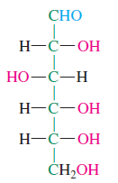
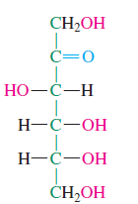
Carbohydrates
General molecular formula C_{n}H_{2n}O_{n} = C_{n}(H₂O)_{n}
Appeared to be hydrates of carbon
Later structural studies indicated that
they do not contain molecules of water

Slide 4
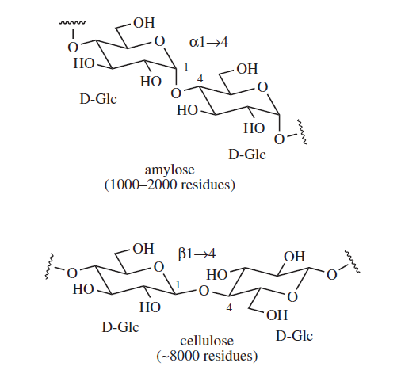
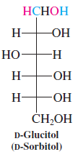
Carbohydrates:
polyhydroxy of
aldehydes,
ketones or acids or
their derivatives,
together with linear and cyclic polyhydoxyls

Slide 5
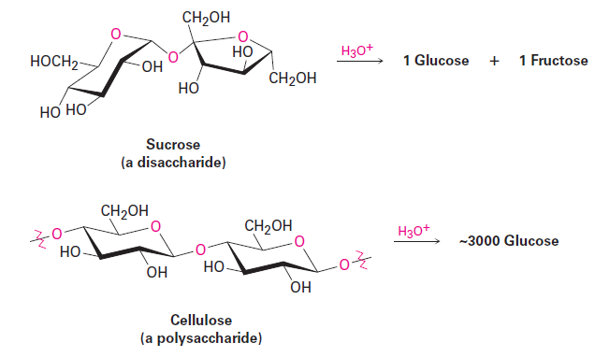
substances that hydrolyze to yield polyhydroxy aldehydes and ketones.

Slide 6
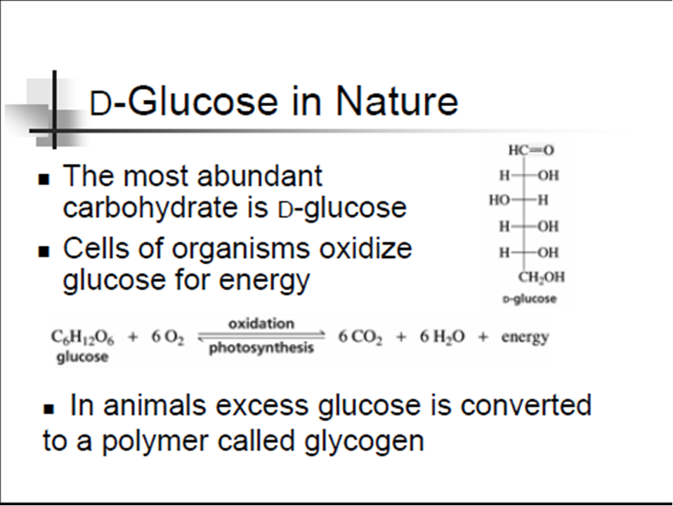

Slide 7
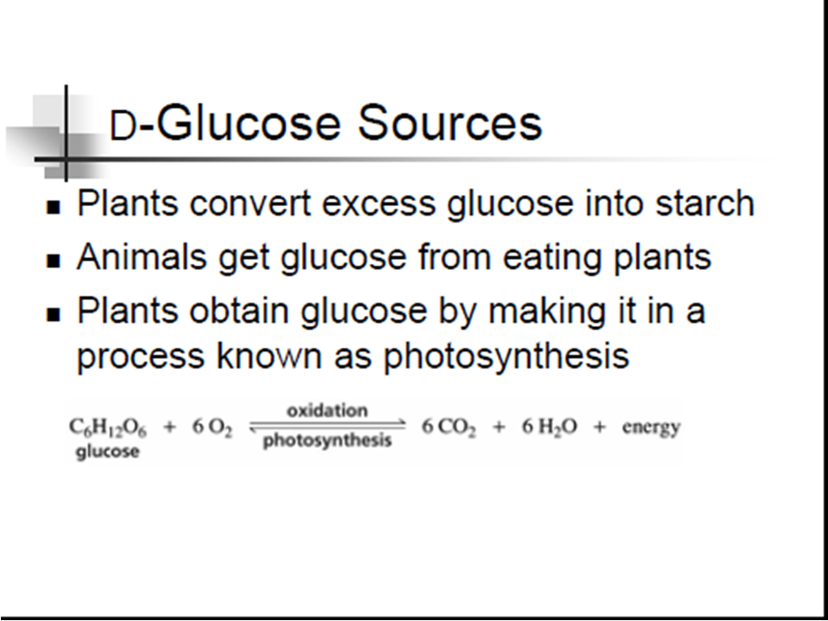

Slide 8
2.2. Classification of carbohydrates

Slide 9
Based on chemical structure and degree of polymerization
Monosaccharides and their derivatives,
Disaccharides (2 monosaccharide units),
Oligosaccharides (3-9 monosaccharide units), and
Polysaccharides (more than 10 monosaccharide units)

Slide 10
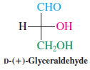
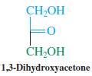
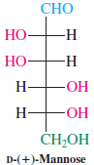
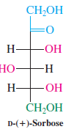
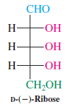
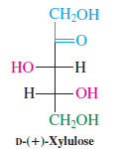
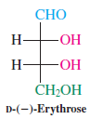
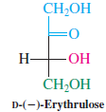
Monosaccharides
a carbohydrate that cannot be hydrolyzed to a simpler carbohydrate
they have the general formula C_{n}H_{2n}O_{n}, where n varies from 3 to 8
chiral polyhydroxyalkanals or polyhydroxyalkanones (except 1,3-di hydroxyacetone)

Slide 11
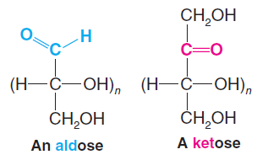
Classified based on:
Functional groups
aldose: a monosaccharide containing an aldehyde group
ketose: a monosaccharide containing a ketone group
Number of carbons
trioses (three carbons), tetroses (four carbons), pentoses (five carbons), hexoses (six carbons), etc

Slide 12
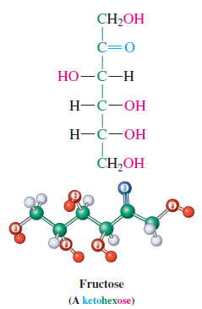
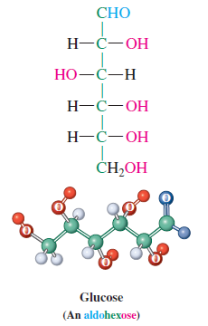
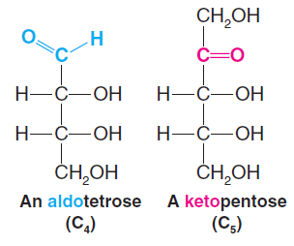
Combination of the two is usually used:

Slide 13
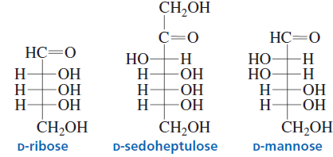
Exercise
Classify the following monosaccharides:

Slide 14
2.3.2. D and L Designations of monosaccharides

Slide 15
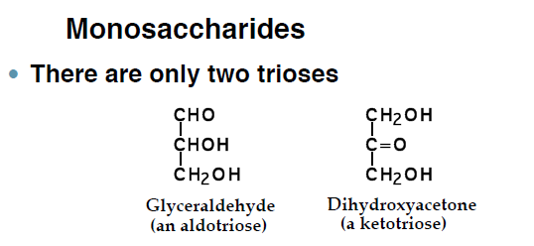
Simplest monosaccharides

Slide 16
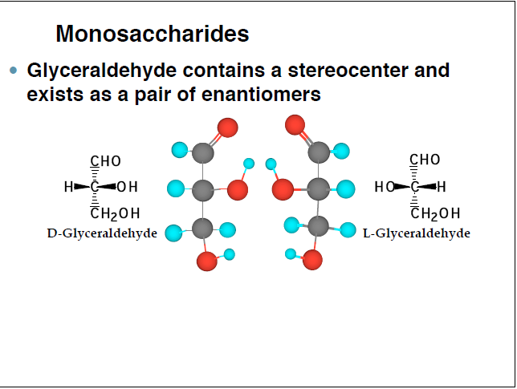
2¹ = 2 enantiomers

Slide 17
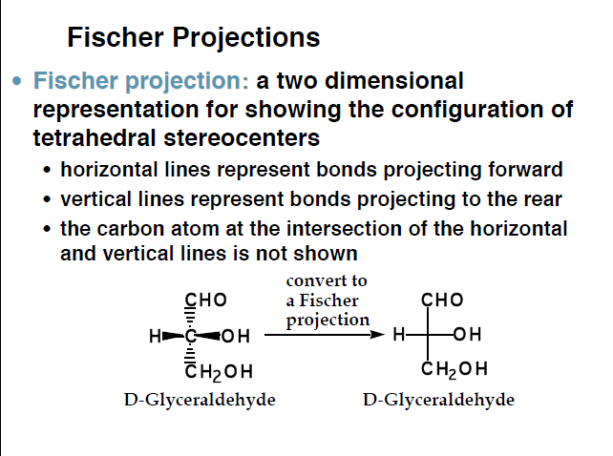

Slide 18
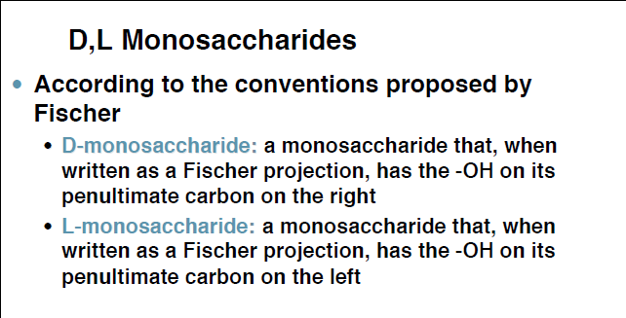
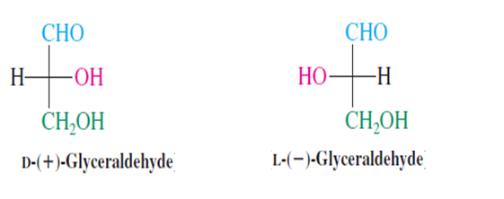

Slide 19
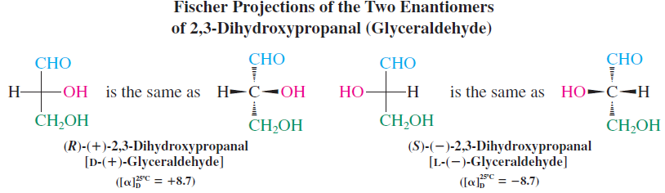
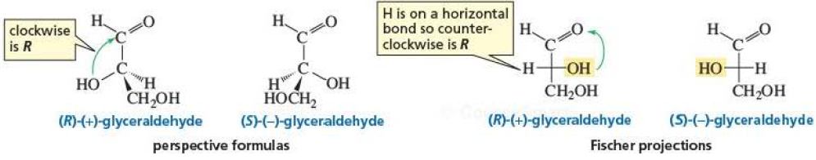

Slide 20
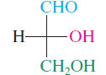
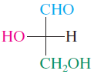
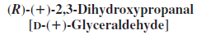
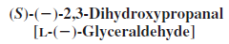
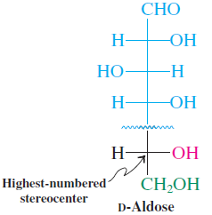
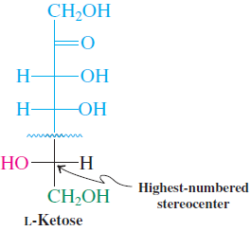
Therefore, glyceraldehyde used as a standard for monosaccharide nomenclature
Fischer projection used
Highest numbered chirality center
Look for the position of the OH
on the last * C compared to the
D and L forms of glyceraldehyde

Slide 21
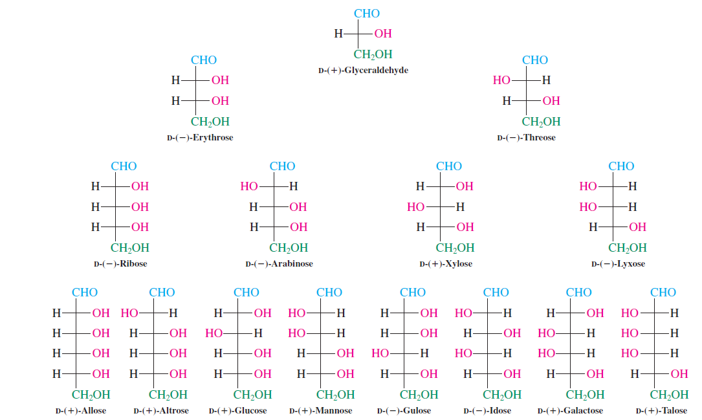

Slide 22
2.3.3. Cyclic structures of monosaccharides

Slide 23
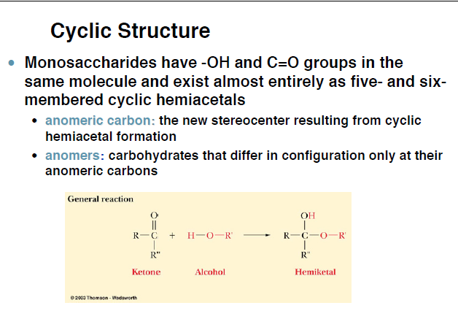

Slide 24
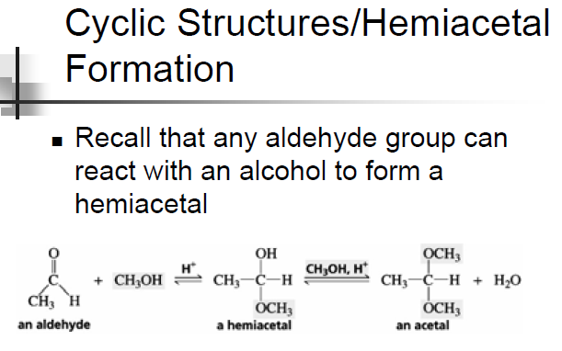

Slide 25
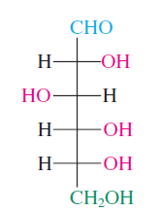
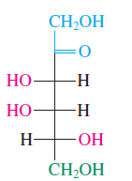
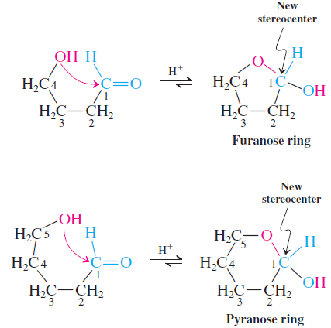
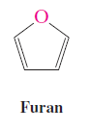
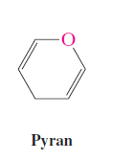
Multifunctional groups
Intramolecular reaction between active groups
nucleophilic addition reaction between a –OH and a C=O group  hemiacetals and hemiketals
Cyclic structures

Slide 26
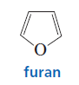
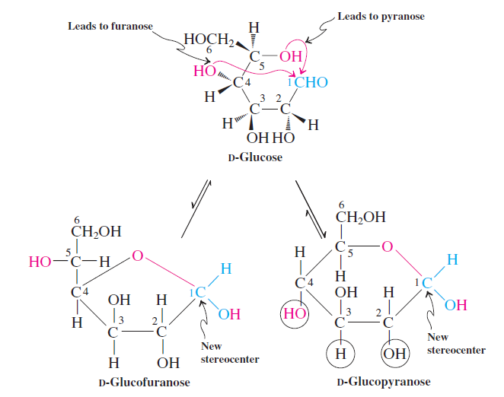
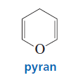
In fact in solution exist as cyclic forms
Six-membered ⇨ Pyranose
Five membered ⇨ Furanose

Slide 27
Carbonyl group carbon
formation becomes chiral center due to hemi acetal or ketal
Anomers
Diastereomers that differs at one stereocenter
Example: anomers of glucose (next slide)

Slide 28
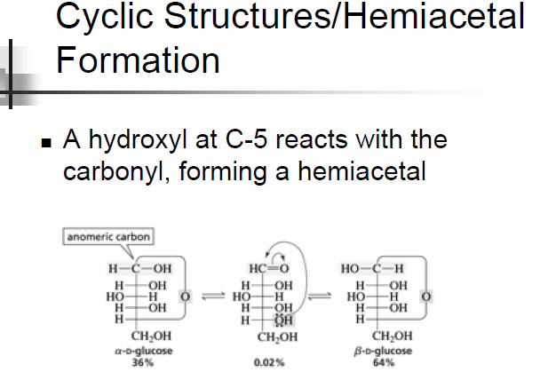

Slide 29
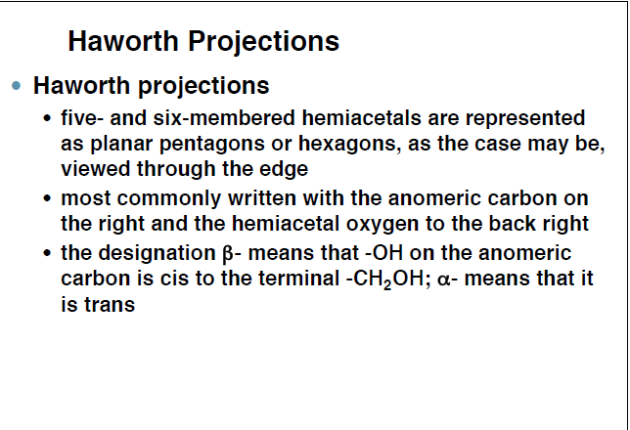

Slide 30
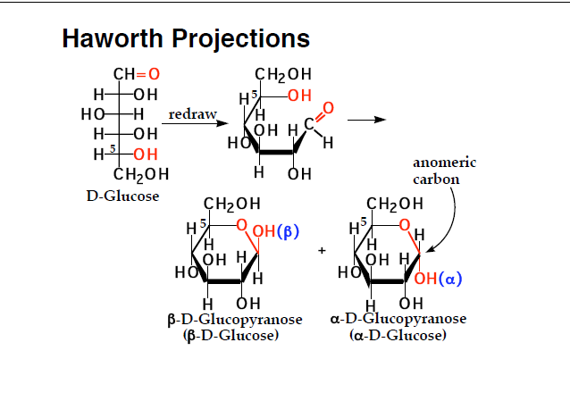

Slide 31
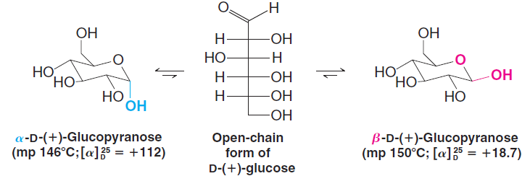
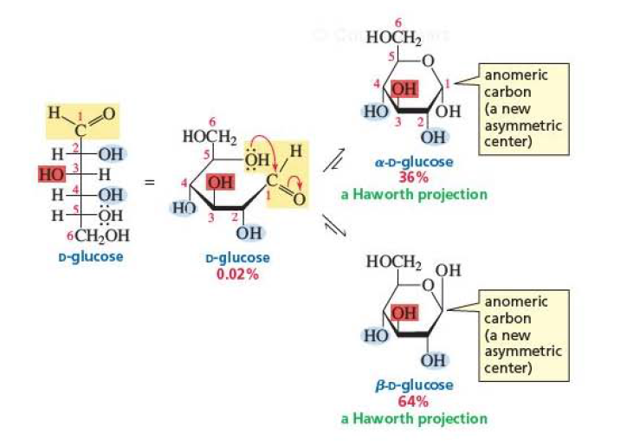

Slide 32
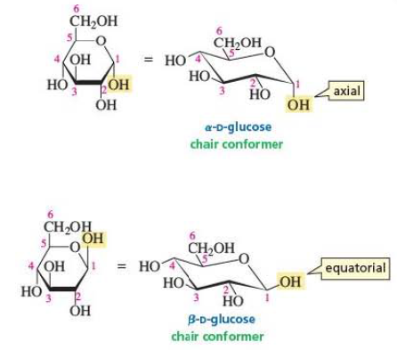
Chair conformation

Slide 33

Why is the β anomer of glucopyranose in higher amount than α anomer?

Slide 34
2.3.4. Mutarotation

Slide 35

Mutarotation
A slow change in optical rotation to an equilibrium value

Slide 36
Exercise: Calculating specific rotations of diastereomeric sugar mixtures
Question:
Calculate how much of the α ([α] = + 112.2°) anomer and how much of the β ([α] = + 18.7°) anomer are present in an equilibrium mixture with a specific rotation of + 52.7°.

Slide 37
Solution:
Note:
The specific rotation of an equilibrium mixture is the average of the rotations of the contributing isomers — however, weighted by the respective mole fractions in the mixture.
Let:
x_{α} % of α anomer ([α] = + 112.2° ) and
x_{β} % of β anomer ([α] = + 18.7°)
Then
x_{α} + x_{β} =100% or x_{β} =100‒ x_{α}

Slide 38
Then:
+ 52.7 = (+112)( x_{α}) + (+18.7)( x_{β})
Substituting 100‒ x_{α} for x_{β}
+ 52.7 = (+112)( x_{α}) + (+18.7)( 100‒ x_{α})
Solving for x_{α}
x_{α} = 36% and x_{β} = 64%

Slide 39
2.3.5. Amino and deoxy sugars

Slide 40

Deoxy sugars
Deoxy sugar is sugar in which a hydroxyl group is replaced by a hydrogen
Methylene group or a methyl group

Slide 41

2-Deoxyribose

Slide 42

Amino sugars
Result from replacement of one or more hydroxyl groups in a sugar by amino groups.

Slide 43


Slide 44

Adriamycin and daunomycin and aminoglycoside antibiotics

Slide 45
2.3.6. Reactions of monosaccharides

Slide 46


Slide 47
2.3.6.3. Reduction

Slide 48


Reduction
Sodium borohydride (NaBH₄) to polyalcohols⇨alditols
Aldoses only one alditol

Slide 49

Ketoses ⇨ Two alditols. Why?

Slide 50


Exercise
What products are obtained from the reduction of

Slide 51
2.3.6.4. Oxidation

Slide 52
Monosaccharides
Oxidations
a. Benedict’s or Tollens’ reagents
b. Bromine water
c. Nitric acid
d. Periodic acid

Slide 53

a. Benedict’s or Tollens’ Reagents: Reducing Sugars:
Oxidize the carbonyl group to aldonic acids

Slide 54


Benedict’s and Fehling’s solution⇨ Cu²⁺

Slide 55


Tollens reagent ⇨[Ag (NH₃)₂⁺OH‒]

Slide 56


Only oxidize only those containing aldehyde functional group.
Why, then, ketoses give positive test?

Slide 57



Reducing sugars
Positive test with Tollens’ or Benedict’s solutions
Only those containing free hemiacetal group or the open chain form of sugar
Acetals or ketals ⇨ Negative test

Slide 58

Summary

Slide 59


b. Bromine water:
Acidic reagent ⇨ No isomerization
Only aldoses
Not strong enough to oxidize a ketose

Slide 60


c. Nitric acid:
Strong oxidizing agent

Slide 61


d. Periodate oxidations: Oxidative cleavage of polyhydroxy compounds:
Cleavage of vicinal diols

Slide 62

Oxidative cleavage of sugars
formic acid, formaldehyde, and CO₂
Facts
C-C cleavge ⇨ 1 molecule of HIO₄
Aldehyde and 2° alcohol ⇨ formic acid
1° OH ⇨ formaldehyde
Ketone ⇨ CO₂
Example:

Slide 63

Exercise
Predict the degradation products of fructose

Slide 64


Slide 65
2.3.6.1. The reactions of monosaccharides in basic solutions: Epimerization and isomerization

Slide 66


Epimers
Two diastereomeric sugars differing only in the configuration at a single asymmetric carbon atom.
The interconversion of epimers is called epimerization.

Slide 67

In basic solution monosaccharides undergo
Epimerization

Slide 68

Isomerization
Ketones
Enediol rearrangement

Slide 69
2.3.6.4. Osazone test: Reaction (reduction) with phenylhydrazine: Epimers

Slide 70

Osazone test:
Reaction of monosacharides with phenylhydrazine
Osazones
1,2-bisarylhydrazone formed by reaction of an aldose or ketose with three molar equivalents of an arylhydrazone

Slide 71

Leads to loss of configuration at C-2
Same osazones

Slide 72

Emil Fisher
D-glucose and D-mannose
Epimers

Slide 73

C-1 and C-2 of ketoses ⇨ Phenylosazones

Slide 74


Exercise
What monosaccharides form the same osazone as D-sorbose?

Slide 75
2.3.6.5. Kiliani–Fischer synthesis: Chain elongation

Slide 76


Kiliani–Fischer Synthesis
Formation of higher monosaccharides (n+1) from lower ones (n)
Two sugars
With different stereochemistry at the original carbonyl carbon
Heinrich Kiliani
(1855 - 1945)
Emil Fischer
(1852 – 1919)

Slide 77


Slide 78

Modified Kiliani–Fischer synthesis
Serianni and Barker in 1979
Cyanohydrins to aldoses
Palladium (on barium sulfate) instead of Na (Hg)

Slide 79



Exercise:
What monosaccharides would be formed in a Kiliani–Fischer synthesis starting with D-xylose?

Slide 80
2.3.6.5. Chain shortening

Slide 81

The Ruff Degradation

Slide 82
2.4. Disaccharides

Slide 83

Disaccharides
glycosides formed from two monosacharides
Connected by glycosidic linkages
So, what are glycosides?

Slide 84


Slide 85


Slide 86
2.4.3. Lactose, Maltose and Cellobiose

Slide 87

Lactose
4-O-(β-D-galactopyranosyl)-β-D-glucopyranose
Product of β-1,4-glycosidic bond link of D-galactose and D-glucose

Slide 88


Maltose and cellobiose
Isomeric dimers of D-glucose

Slide 89
2.6. Polysaccharides

Slide 90
Polysaccharides
Polymers of > 10 monosaccharides
Property
species of monosaccharides
types of linkages between residues
extent and type of chain branching

Slide 91
2.6.1. Classification of polysaccharides

Slide 92
Based on source
Plant polysaccharides
Animal polysaccharides
Algal polysaccharides,
Bacterial polysaccharides, etc

Slide 93
B. Based on composition
Polysaccharides
Homo
polysaccharides
Hetero
polysaccharides
Homo polysaccharides- gives single monosaccharide units on hydrolysis
Hetero polysaccharides- gives more than one monosaccharides units on hydrolysis

Slide 94
2.6.3. Starch

Slide 95

Starch
Polymer of glucose
Amylose
Unbrached polymer of D-glucose α-1,4-glycosidic linkages

Slide 96

Amylopectin is a branched polysaccharide
Main chain: α-1,4-glycosidic linkages
Branching : α-1,6' glycosidic linkage
Limited solubility

Slide 97
2.6.4. Cellulose

Slide 98

Cellulose
β-1,4’-g1ycosidic linkages
Intramolecular hydrogen bonds +
Intermolecular hydrogen bonds
Reduce water solubility +
Strong fibers

